Slide 1
2024
OpenVox Introduction
VoIP Gateway/ Unified Communication Platform
Uscale Unified Gateway/ IPPBX/ Telephony Card

Slide 2
CONTENTS
https://www.ypppt.com/
02
04
01
03
Honor
Customers
Profile
Products

Slide 3
Profile

Slide 4
Profile
OpenVox Communication Co., Ltd
Founded in 2002, OpenVox has now evolved to become a global leading provider of open source telephony hardwares and software products. OpenVox serves the Small and Medium Business and open source markets with superior quality products that lower communication costs, increase system flexibility and enhance productivity in building PBX, Call Center, IVR and firewall applications. OpenVox continues to deliver innovative and cost effective solutions to the open source communities and will always do.

Slide 5
Honor

Slide 6
Honor
Except for products and services, OpenVox is also complimented for environmental protection. It is not only the first supplier to meet EU RoHS green environmental protection standard, but also adopt thin card design with CE、FCC certificate and more than ten special certificates in some local countries.
请输入关键字
单击此处添加文本，本模块所有图形线条及相应素材均可自由编辑，建议您选择微软雅黑等系统自带字体

Slide 7
Products

Slide 8
Products
VoIP Gateway
UScale Series
VoIP gateways convert information, data or other communications from one protocol or format to another.
The UScale series is a core voice switching equipment for communication solutions, targeting business with up to 300-20000 users. It is compatible with various IP terminals and provides professional IP voice and unified communication solutions.
OpenVox
IPPBX
Telephony Card
IPPBX delivers a multi-functional business office telephony system designed for almost all kinds of enterprises.
OpenVox Telephony card delivers great voice quality in the telephony systems. It supports industry standard telephony and data protocols.

Slide 9
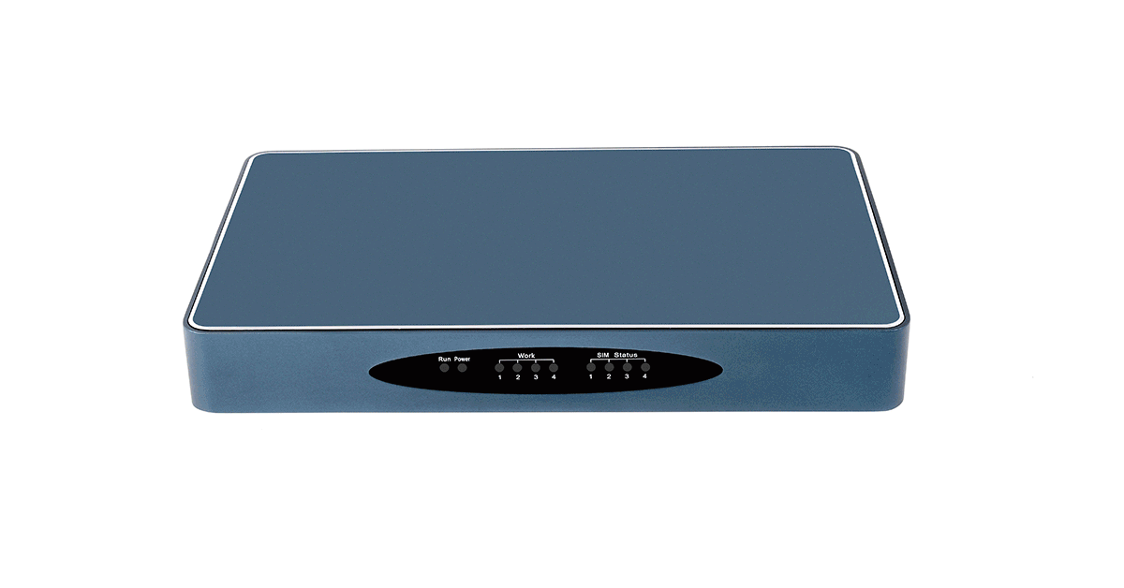
Products
01
Wireless Gateway
SWG Series Wireless Gateway
GWP Series Wireless Gateway
02
Analog Gateway
FXS/FXO VoIP Gateway
ATA VoIP Gateway
VoIP Gateway
03
E1/T1 Gateway
E1/T1 Gateway
Notes:
大类介绍版式1

Slide 10
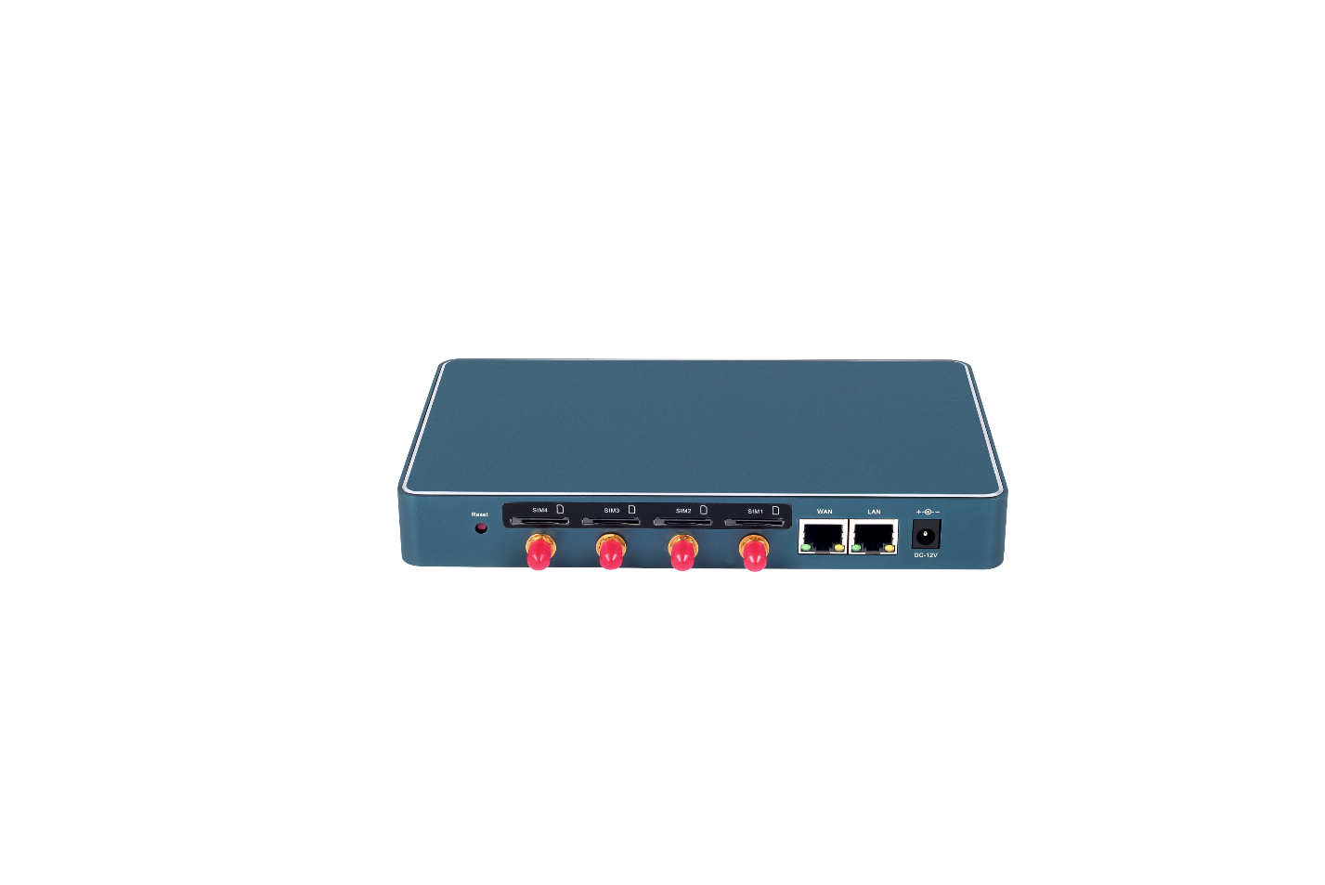
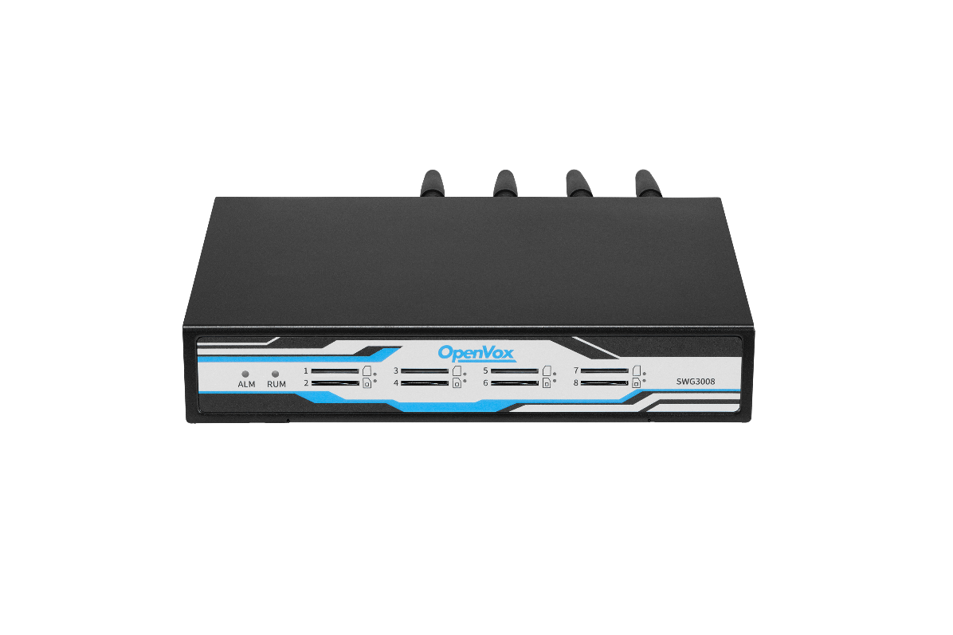
Wireless Gateway —— SWG Series
SWG-M202/204
Supports 2/4 GSM/WCDMA/LTE channels
Designed for Small and Medium Enterprises, SOHOs
Compact, light and convenient
Abundant HD Voice Codecs
PART 01
SWG-3008
Provides 8 GSM/WCDMA/LTE channels
Hot-swap SIM cards with no service interruption
Equipped with double Ethernet ports that meet various need
PART 02
Notes:
产品介绍版式1

Slide 11
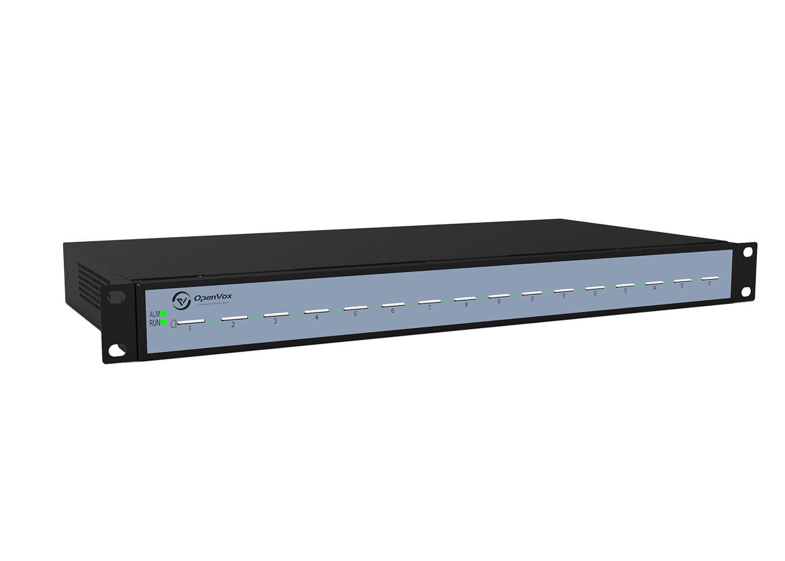
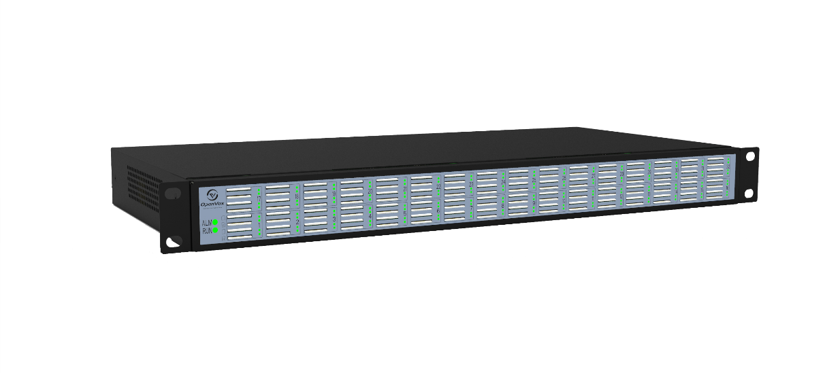
Wireless Gateway —— SWG Series
SWG-3016/32
Provides 16/32 GSM/WCDMA/ LTE/ channels
Hot-swap SIM cards with no service interruption
Equipped with double Ethernet ports that meet various need
SWG-3016/32-4S
Policy-based SIM Auto Switch
Dynamic allocation of SIM cards
Support a variety of protocol ranges
Provides 16/32 GSM/WCDMA/LTE channels

Slide 12
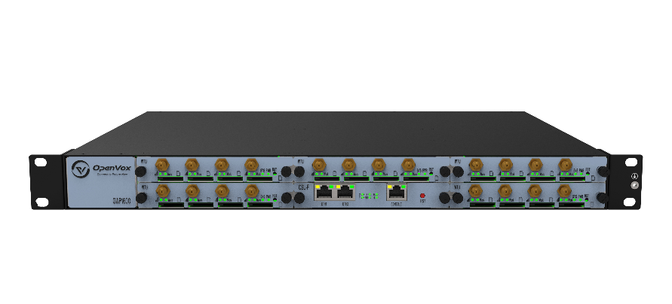
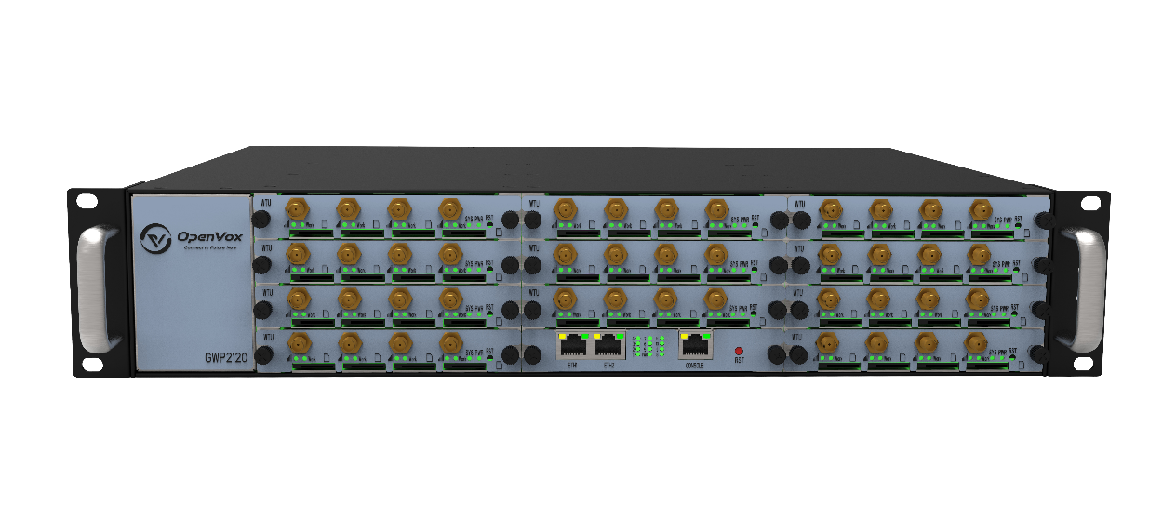
Wireless Gateway —— GWP Series
Provides up to 5 plug-in GSM/ WCDMA/LTE gateway modules
Support from 4 to 20 GSM/ WCDMA/LTE channels and 2 Ethernet ports
Support VS-GWM420G and VS-GWM420L modules
VS-GWP1600
Provides up to 11 plug-in GSM/ WCDMA/LTE gateway modules
Support from 4 or 44 GSM/ WCDMA/ LTE channels and 2 Ethernet ports
Support VS-GWM420G and VS-GWM420L modules
VS-GWP2120

Slide 13
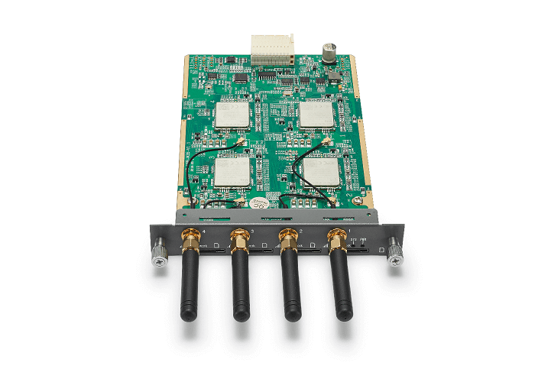
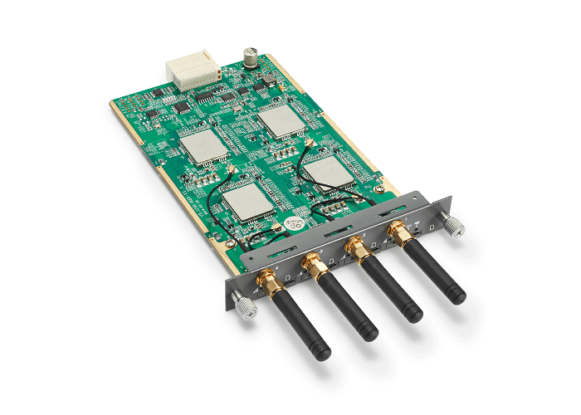
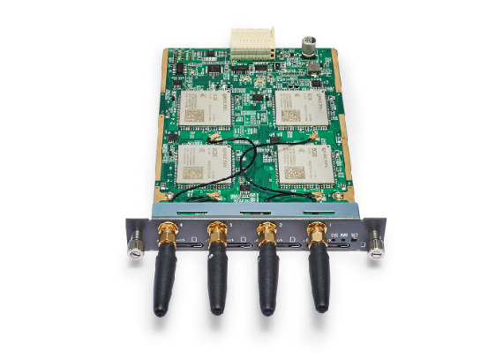
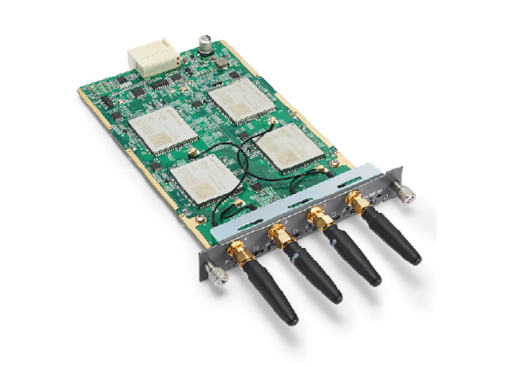
Wireless Gateway —— GWP Series
Frequency range: GSM 850/900/1800/1900MHz
Each module offers 4 GSM channels
VS-GWM420G
Frequency range:
VS-GWM420L-CE R2.1 China/India
LTE FDD: B1/B3/B5/B8 LTE TDD: B38/B38/B40/B41
WCDMA: B1/B8 TD-SCDMA: B34/B39
CDMA: BC0 GSM: 900/1800MHz
VS-GWM420L-E EMEA/Korea/Thailand
LTE FDD: B1/B3/B5/B7/B8/B20 LTE TDD: B38/B40/B41
WCDMA: B1/B5/B8 GSM: B3/B8
VS-GWM420L-AU Australia/New Zealand/Taiwan/Brazil
LTE FDD: B1/B2/B3/B4/B5/B7/B8/B28
LTE TDD: B40
WCDMA: B1/B2/B5/B8 GSM: B2/B3/B5/B8
VS-GWM420L

Slide 14
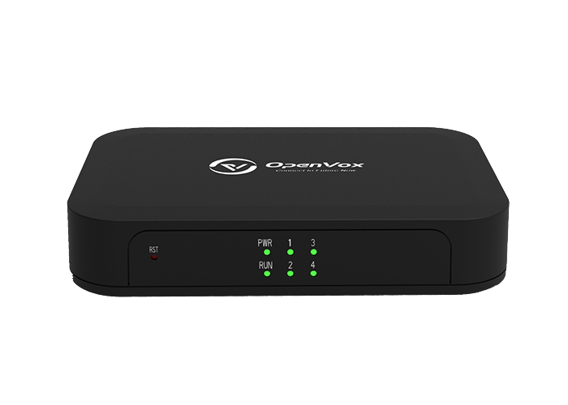
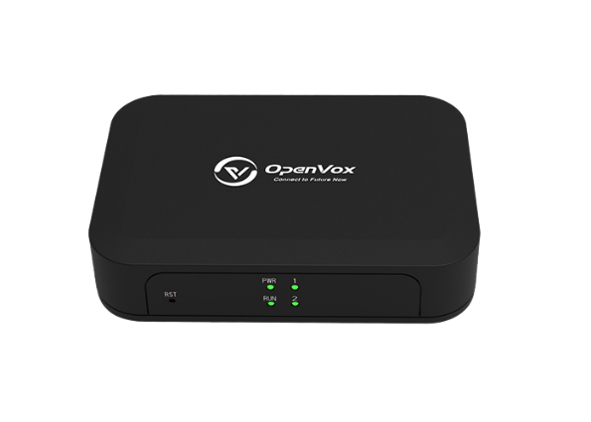
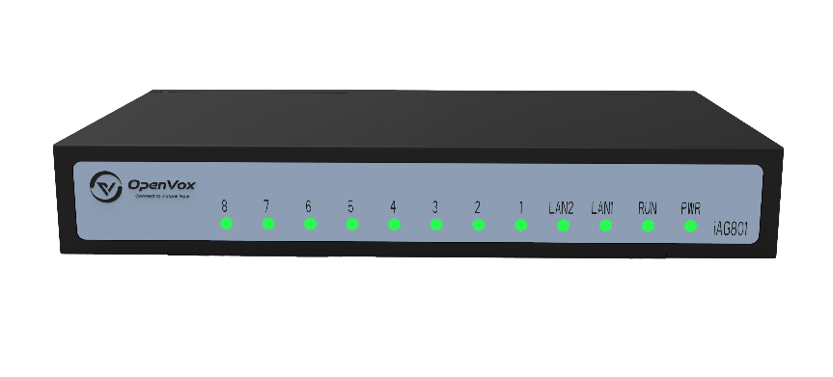
Analog Gateway —— ATA VoIP Gateways
Use standard SIP protocols
Designed for SMBs and SOHOs
Supports 2 FXS ports
Use standard SIP protocols
Designed for SMBs and SOHOs
Supports 4 FXS ports
Use standard SIP protocols
Designed for SMBs and SOHOs
Supports 8 FXS ports
A cost-effective version of iAG800 V2
iAG200-S
iAG400-S
iAG801

Slide 15
Analog Gateway —— FXS/FXO VoIP Gateways
Use standard SIP protocols
Designed for SMBs and SOHOs
Supports 2 FXO ports
Use standard SIP protocols
Designed for SMBs and SOHOs
Supports 4 FXO ports
Use standard SIP protocols
Designed for SMBs and SOHOs
Supports 4/8 FXS/FXO ports
iAG200-O
iAG400-O
iAG800 V2

Slide 16
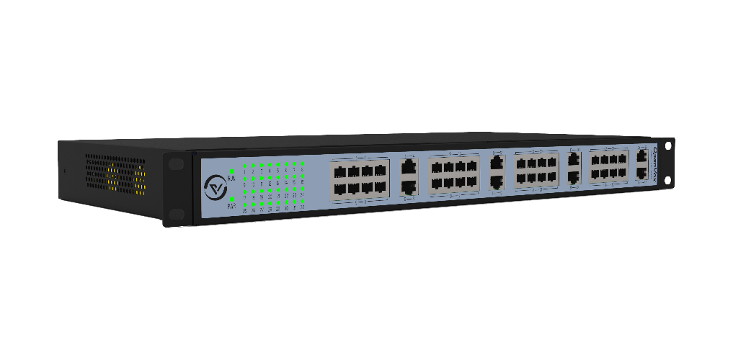
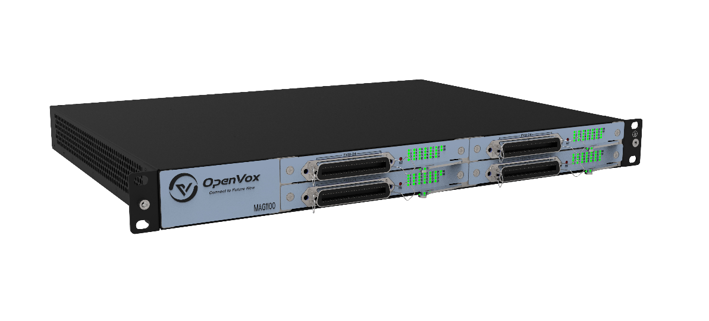
Analog Gateway —— FXS/FXO VoIP Gateways
MAG1000
Use standard SIP protocols
Supports 16/24/32 FXS/FXO port combination
Compatible with Leading IMS/NGN platform，IPPBX and SIP servers
MAG1100
Use standard SIP protocols
Supports 48/72/96 FXS port combination
Compatible with Leading IMS/NGN platform，IPPBX and SIP servers

Slide 17
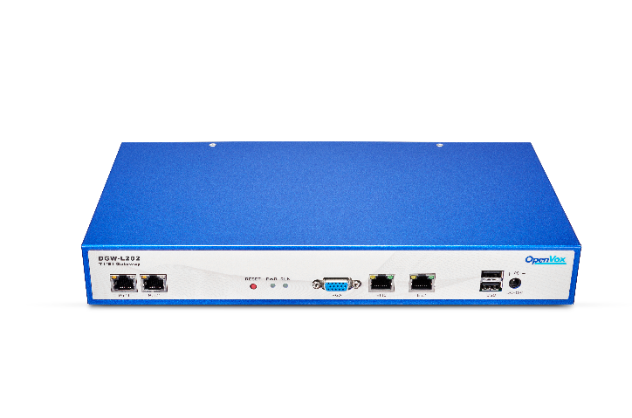
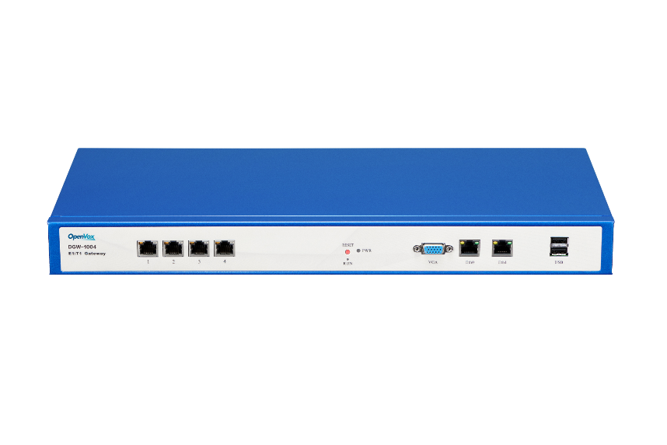
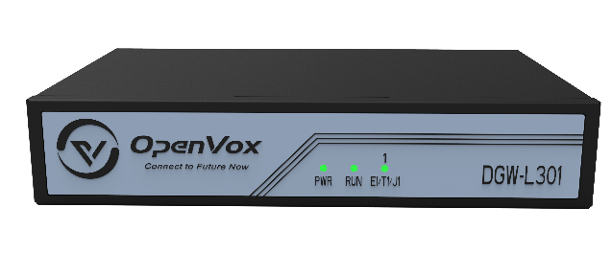
E1/T1/J1 Gateway
Supports 1 software-selectable E1/T1/J1 interface
Supports Up to 30 concurrent calls
Signalling: PRI/R2/SS7
Supports 100M Ethernet port * 2
Echo Cancellation & transcoding
Supports 1/2/4 software-selectable E1/T1/J1 interface
Supports 30/60/120 concurrent calls
Supports 1000M Ethernet port * 2
Signalling: PRI/R2/SS7
Echo Cancellation & transcoding
Supports 1/2/4 software-selectable E1/T1/J1 interface
Supports 30/60/120 concurrent calls
Supports 1000M Ethernet port * 2
Signalling: PRI/SS7/R2
Echo Cancellation & transcoding
Supports redundant power supply
DGW-L301
DGW-L20X
DGW-100X(R)

Slide 18
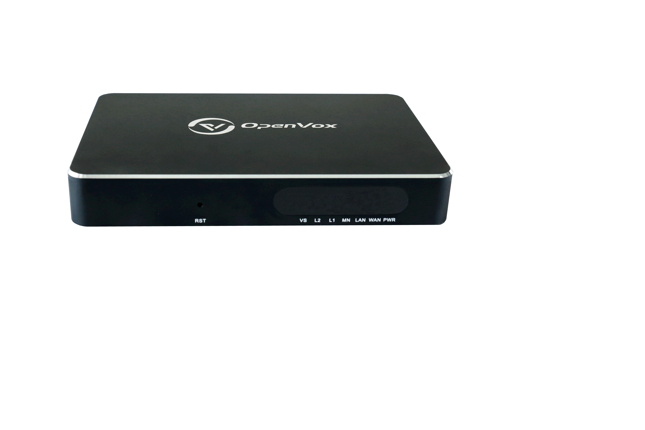
Products
UC Series
UC120P 、 UC200 、 UC1000 、 UC300 、 UC501
IX Series
IX160/IX160P
IP Phone
C200、C401
Unified Communication Platform
IPPBX
Host、Main Control Module、Gateway Module、Accessories
Notes:
大类介绍版式1

Slide 19
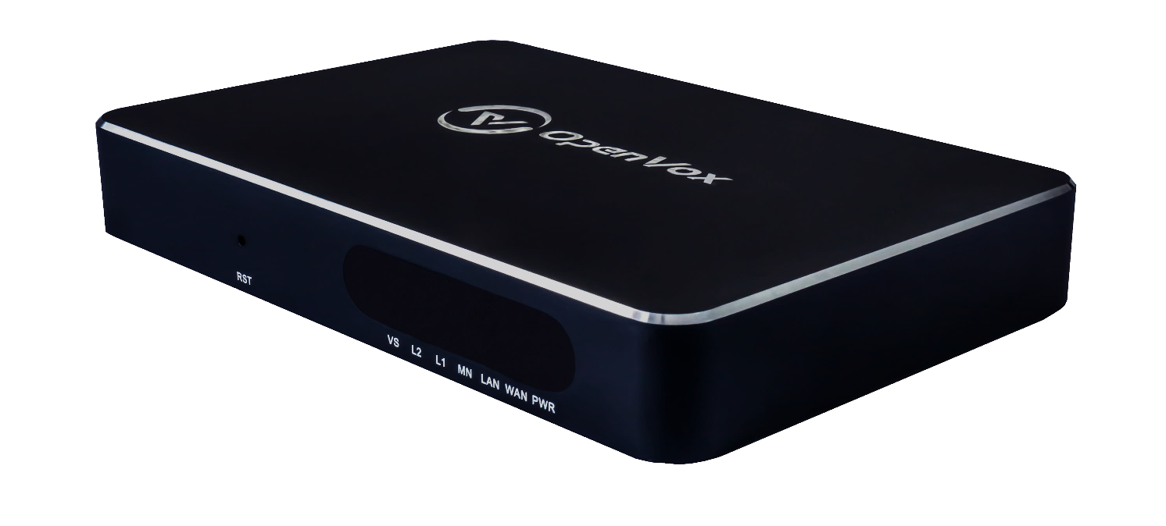
IPPBX—— UC Series
OpenVox UC 120P IPPBX
Provides FXS, FXO, GSM/LTE
Support up to 15 concurrent calls
Equipped with 2 * 10/100 Base-T RJ45 interface that meet various need
Compact, lightweight and High Availability(Hot Standby)

Slide 20
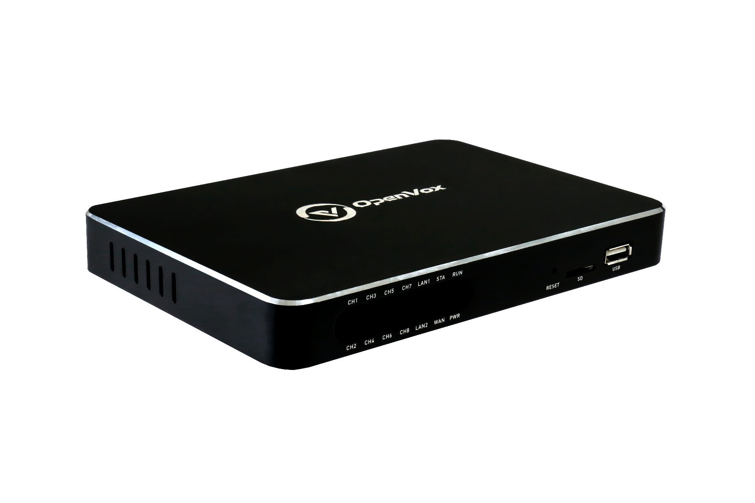
IPPBX—— UC Series
OpenVox UC 200 IPPBX
Provides FXS, FXO
Support up to 30 concurrent calls
Support up to 8 analog interfaces
Equipped with 3 * 10/100 Base-T RJ45 interface that meet various need
Open Application Programming Interface (MQTT API)

Slide 21
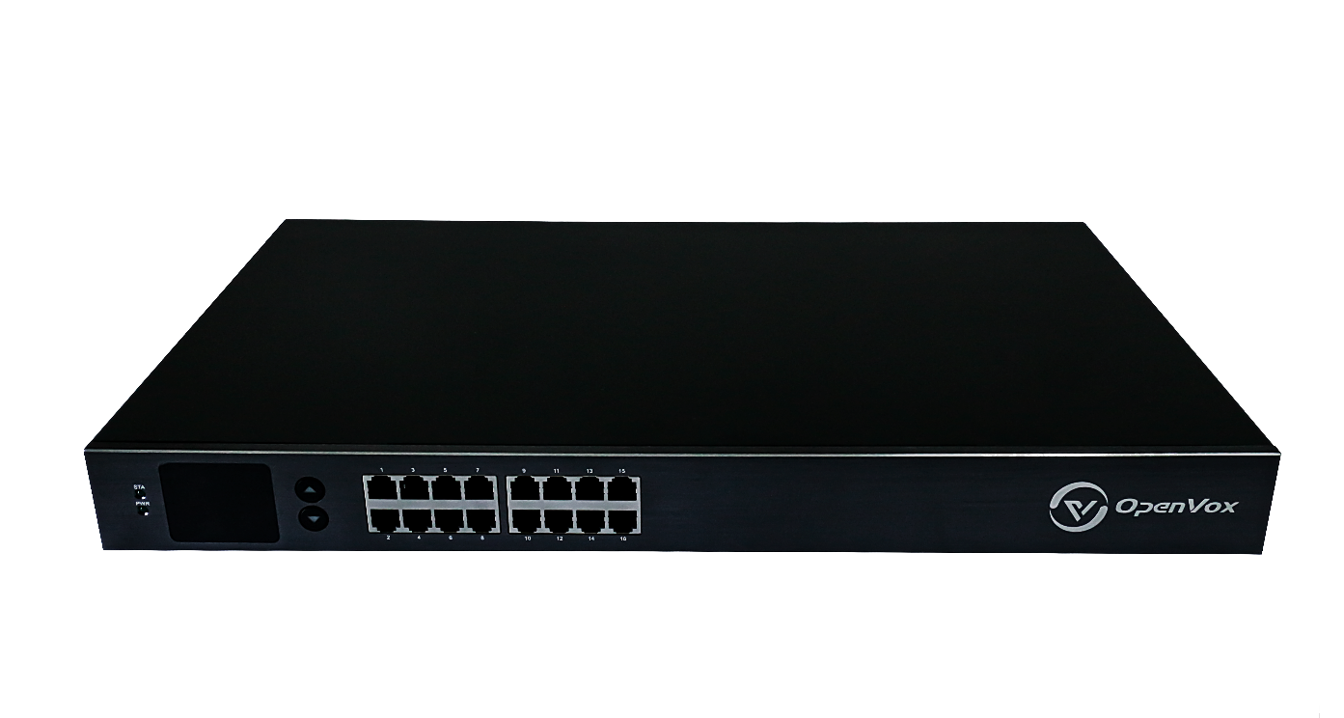
IPPBX—— UC Series
OpenVox UC 1000 IPPBX
Provides FXS, FXO
Support up to 60 concurrent calls
Support up to 40 analog interfaces
Equipped with 4 * 10/100/1000 Base-T RJ45 interface that meet various need
Open Application Programming Interface (MQTT API)

Slide 22
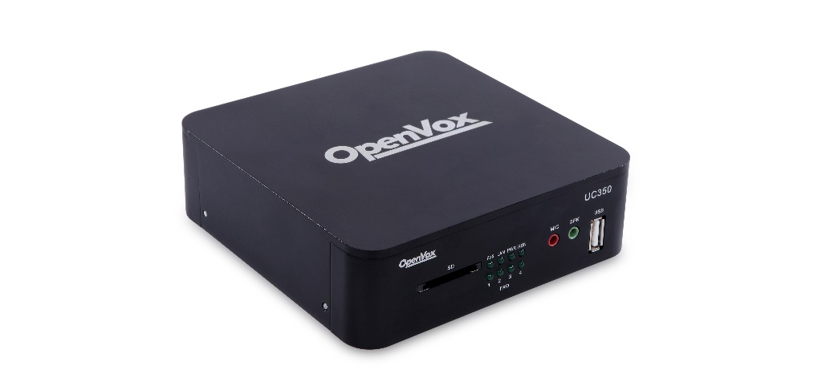
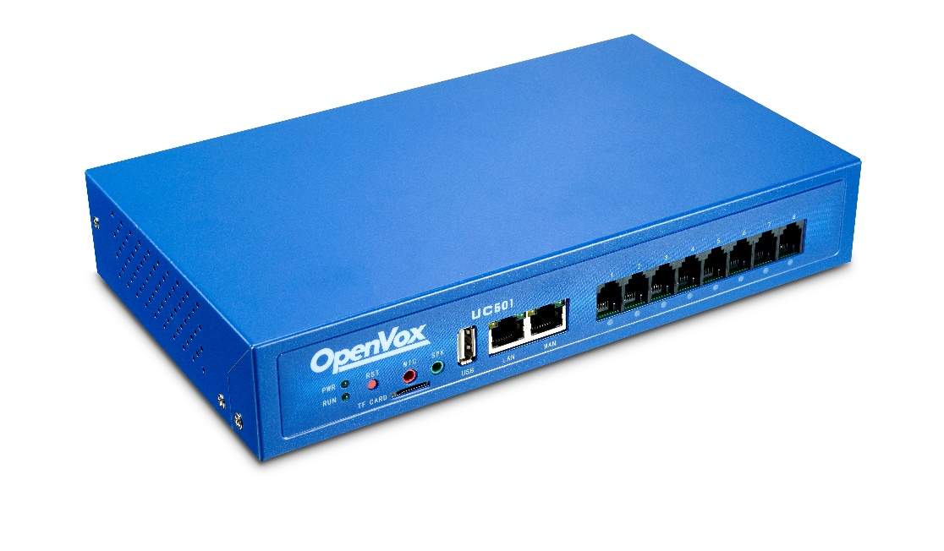
IPPBX—— UC Series
Can easily support under 100 users
Support industry standard SIP trunks, IAX2 trunks, analog PSTN trunks, and analog station trunks
Up to 5 Analog Ports with Failover Function
UC300
Modular design, customizable with FXO-200/FXS-200/FXOS-200 module
With Quad Core processors, UC501 can easily support under 150 users
UC501

Slide 23
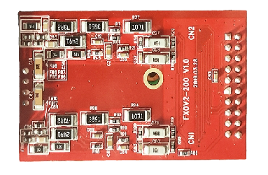
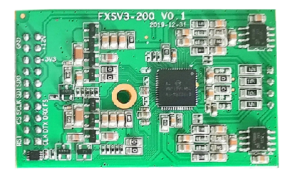
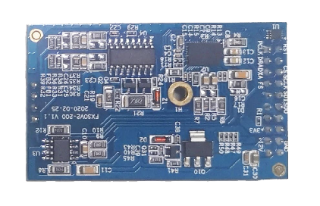
IPPBX——UC Series ——Module
Allows OpenVox UC series IPPBX Module to terminate 2 analog PTSN lines per module
Allows OpenVox UC series IPPBX Module to terminate 2 analog telephone lines per module
Dual-channel module
Builds 1 FXO and 1 FXS channels with failover capability
FXO-200
FXS-200
FXOS-200

Slide 24
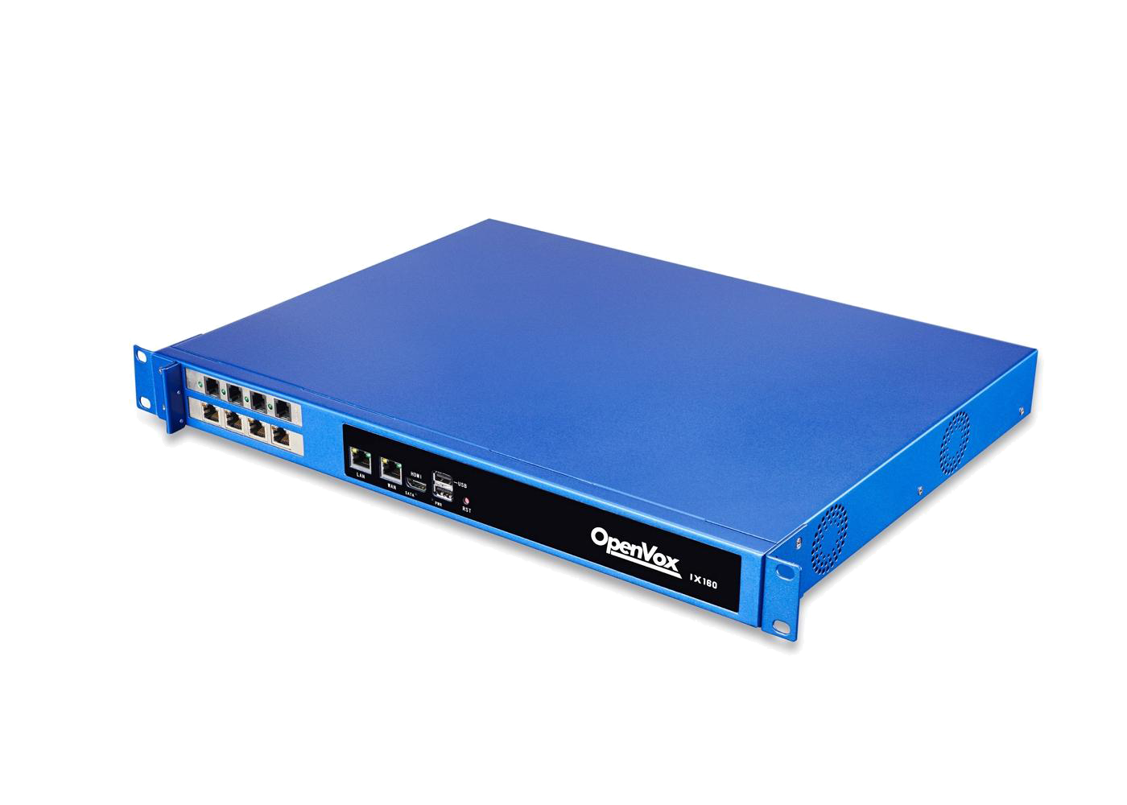
IPPBX—— IX Series
OpenVox IX160/160P IPPBX
Supports combination of two cards, includes FXS/FXO, BRI or E1/T1/J1 interfaces
Up to 600 concurrent calls and 2000 users
Uninterruptible Power Supply (UPS): Yes (Optional)
RAID: Yes (Optional)
Built-in Redundant Power Supply (RPS)

Slide 25
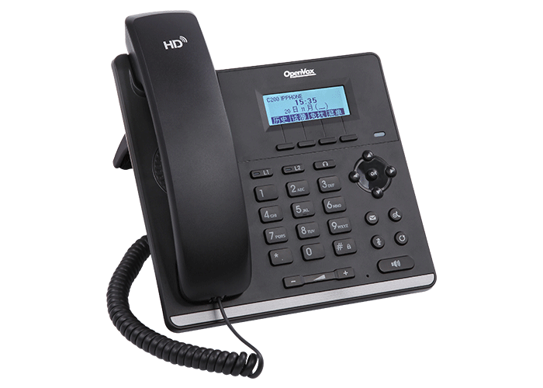
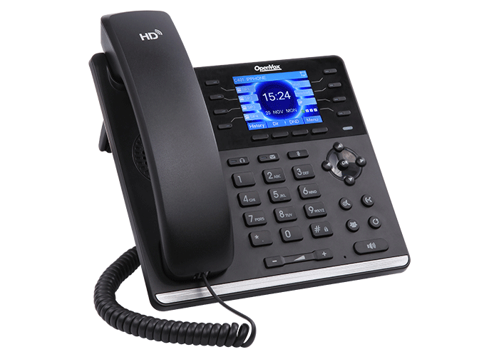
IPPBX —— IP Phone —— C Series
C200
C401
Model | C200 | C401
SIP Line | 2 Lines | 4 Lines
Display | 128*48 dot-matrix with backlight screen | 2.8 inch LCD color-screen
Network | 1 * 10/100M | 1* 10/100/1000M
POE | 802.3af Class 1 POE | 802.3af Class 2 POE
Voice | HD Voice
VPN | OpenVPN
Notes:
产品介绍版式2

Slide 26
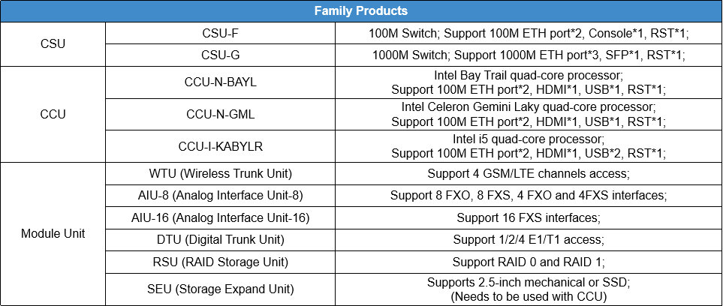
IPPBX—— Unified Communication Platform —— Module
Unified Communication Platform
UCP is an ideal solution to integrate data, voice and video in one product for SME market. UCP supports Core Switch Unit (CSU), Core Control Unit(CCU), and Module Unit. The Module Unit includes WTU, AIU, DTU, RSU and SEU, supporting access to GSM/LTE lines, analog lines, digital lines, RAID and storage expansion.

Slide 27
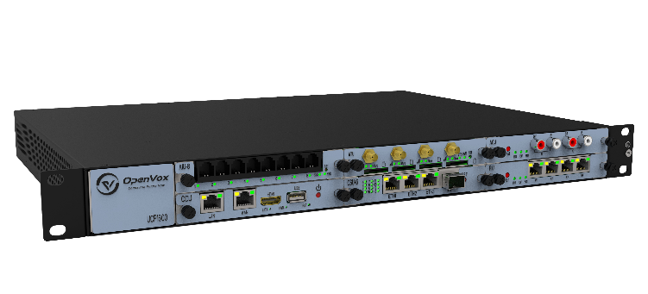
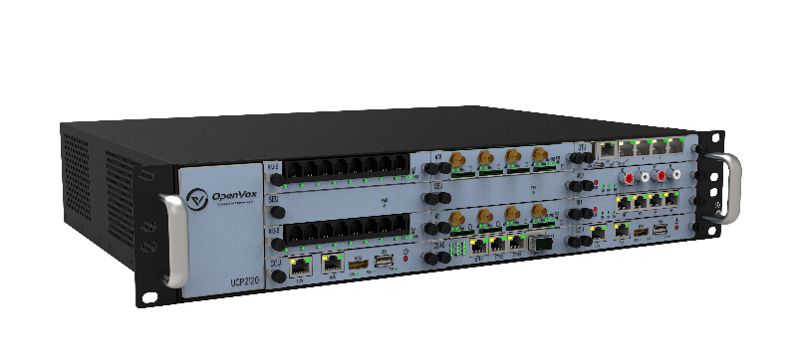
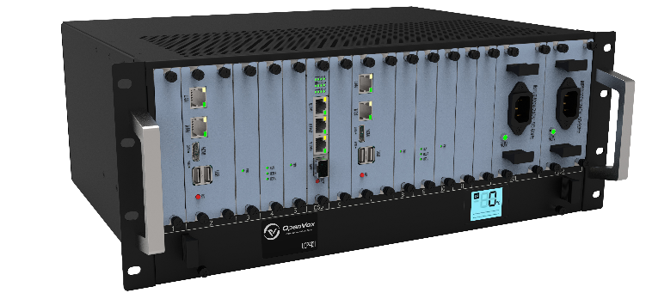
Unified Communication Platform —— Host
Provide 1 core switch slot, 1 core control board slot and 4 module board slots
Support Core Switch Unit (CSU), Core Control Unit (CCU) and Module Unit
Provide 1 core switch slot, 2 core control board slots and 9 module board slots
Support Core Switch Unit (CSU), Core Control Unit (CCU) and Module Unit
Provide 1 core switch slot, 2 core control board slots, 9 module board slots and 2 power supply slots;
Support Core Switch Unit (CSU), Core Control Unit (CCU) and Module Unit
UCP1600
UCP2120
UCP4131

Slide 28
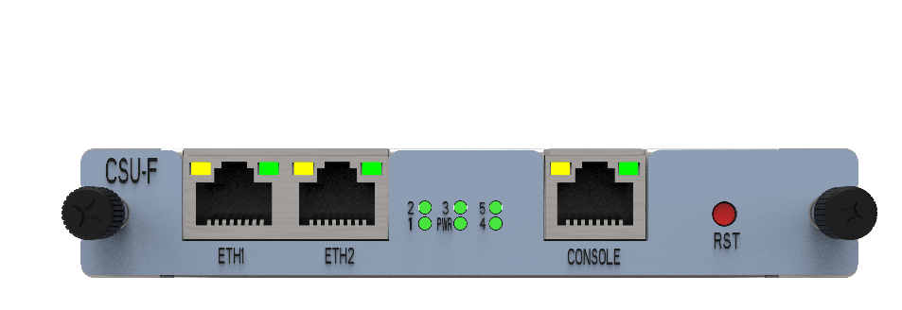
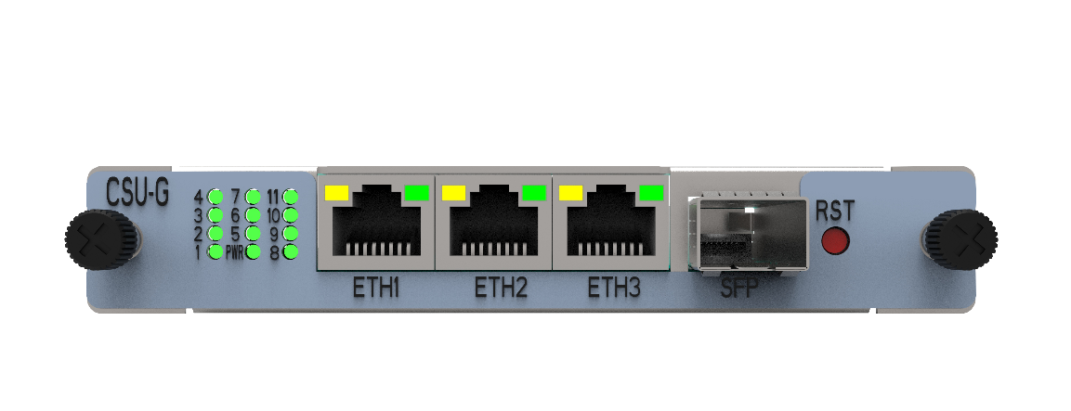
Unified Communication Platform —— Core Switch Unit
100M Switchboard
Provides 2 Ethernet ports, 1 Console port, and 1 RST key
CSU-F
1000M Switchboard
Provides 3 Ethernet ports, 1 SFP port, and 1 RST key
CSU-G

Slide 29
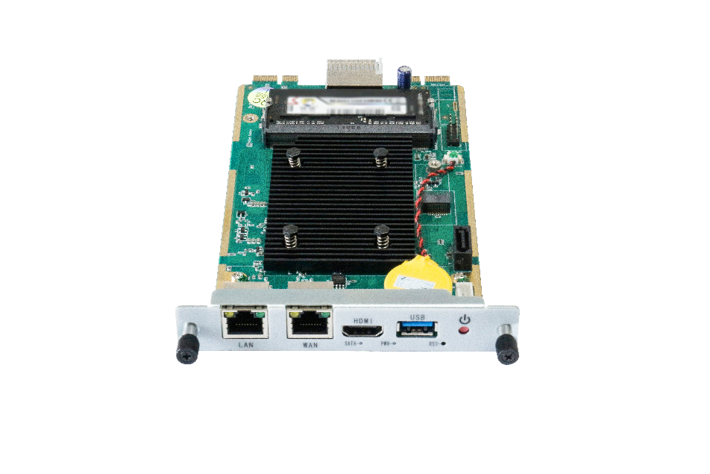
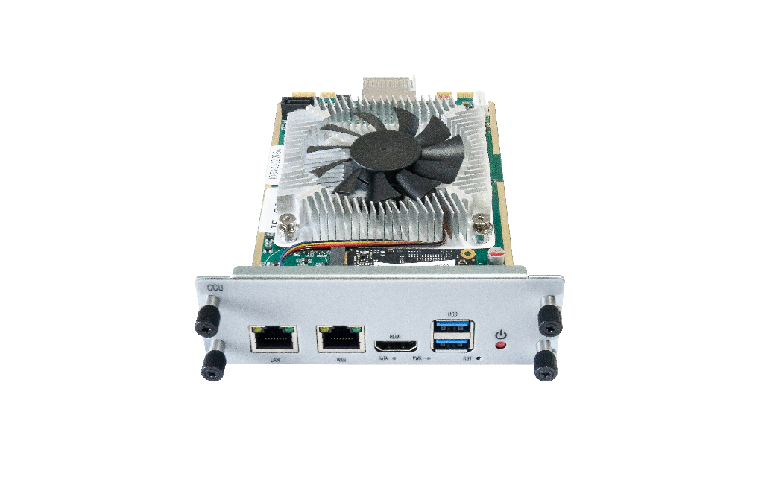
Unified Communication Platform —— Core Control Unit
Intel Bay Trail quad-core processor;
2 USB ports; 2 Ethernet ports; 1 VGA port;
CPU: 1.83GHz Intel(R) Celeron(R) N2930
RAM: Up to 8GB DDR3L 1333
Intel Celeron Gemini Laky quad-core processor;
1 USB port; 2 Ethernet ports; 1 HDMI port;
CPU: 1.10G Intel(R) Celeron(R) N4120
RAM: Up to 8GB DDR4-2400
Intel 11th i5 quad-core processor;
2 USB ports; 2 Ethernet ports; 1 HDMI port;
CPU: 3.20 GHz Intel(R) Core(R)
RAM: Up to 32GB DDR4-2400
CCU-N-BAYL
CCU-N-GML
CCU-I-TGL

Slide 30
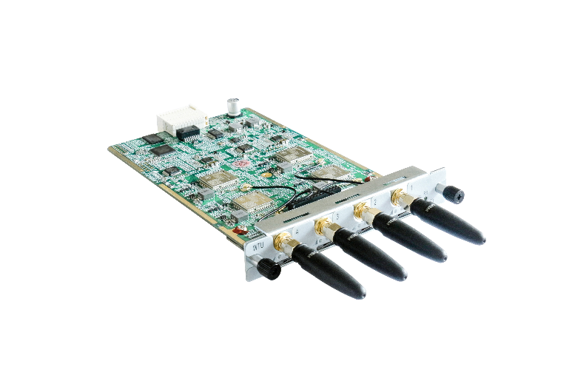
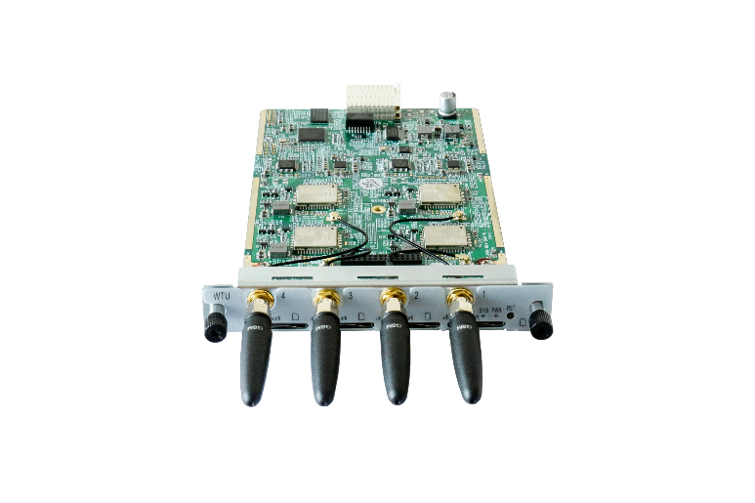
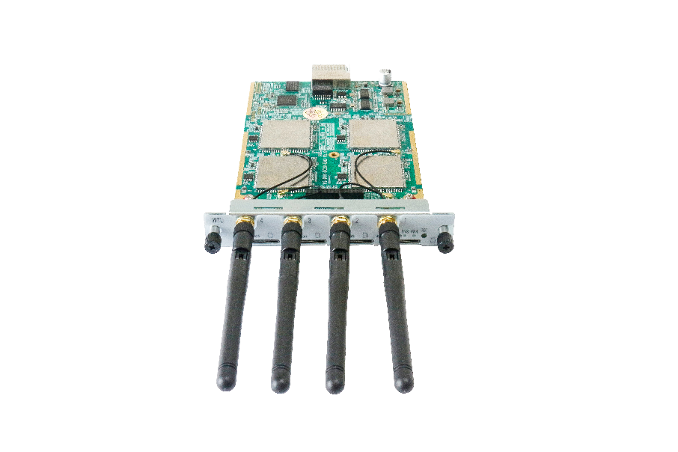
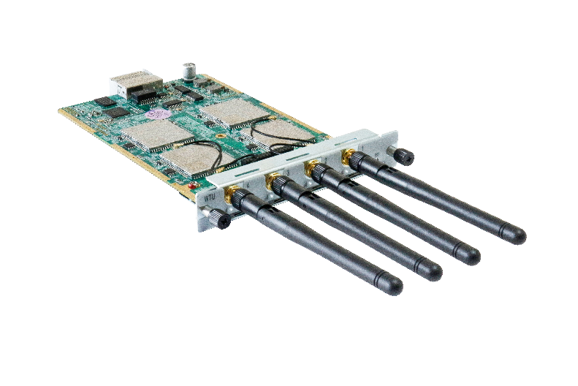
Unified Communication Platform —— Module Unit
Each WTU-GSM module offers 4 GSM channels
Bring users excellent HD voice service with multiple codecs, including G.711U, G.711A, GSM, G.722, G.726, G.72
WTU-GSM
Each WTU-LTE module offers 4 LTE channels
Bring users excellent HD voice service with multiple codecs, including G.711U, G.711A, GSM, G.722, G.726, G.729
WTU-LTE

Slide 31
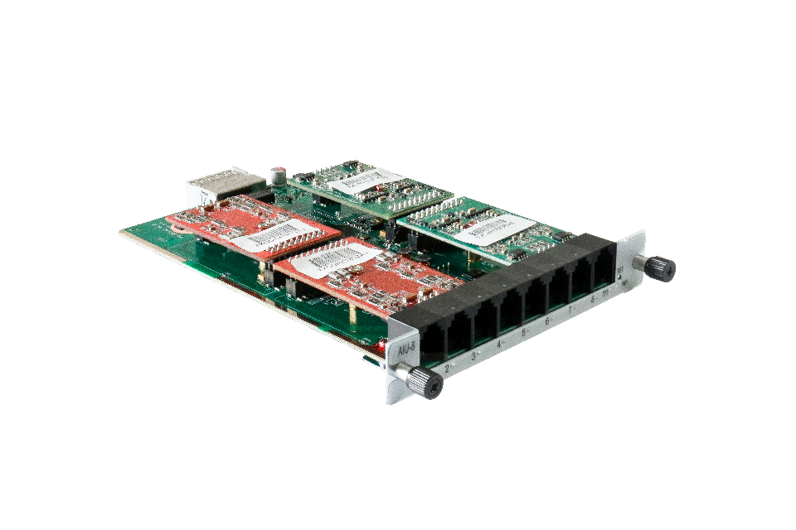
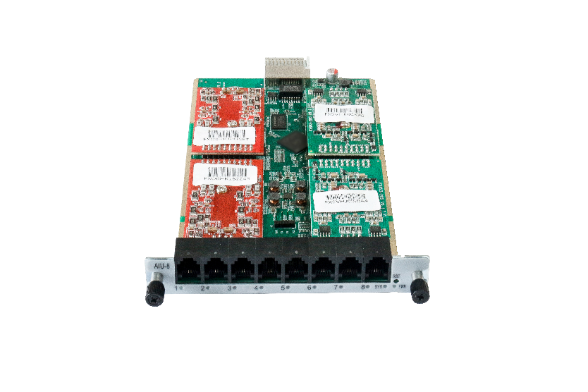
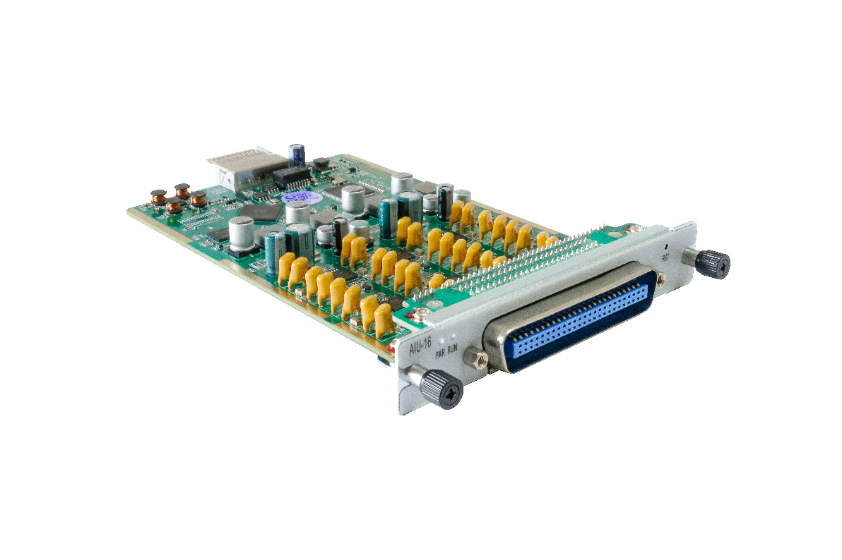
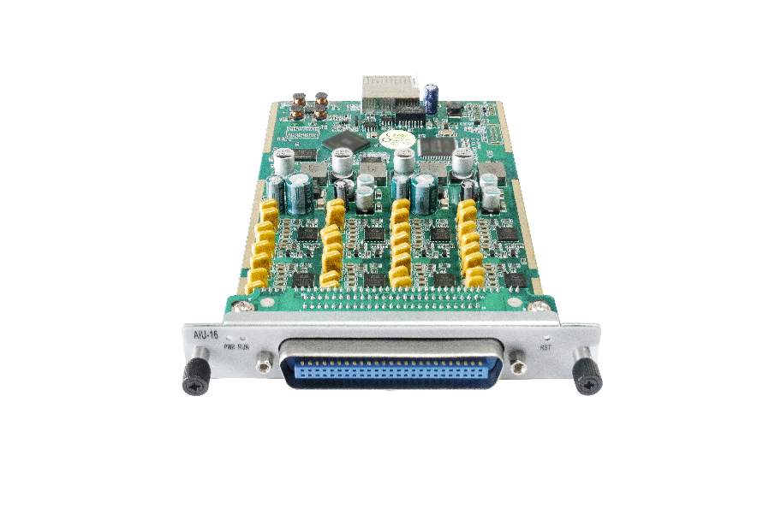
Unified Communication Platform —— Module Unit
Each AIU-8 module offers 4 FXO and 4 FXS ports, 8 FXS ports or 8 FXO ports
Support DHCP, DNS/DDNS, NAT networking, DTMF relay
AIU-8
Each AIU-16 module offers 16 FXS ports
Support DHCP, DNS/DDNS, NAT networking, DTMF relay
AIU-16

Slide 32
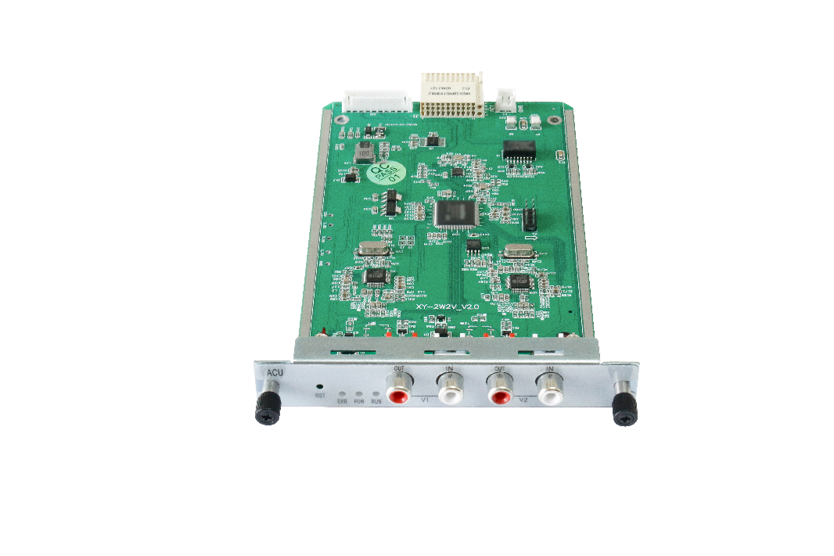
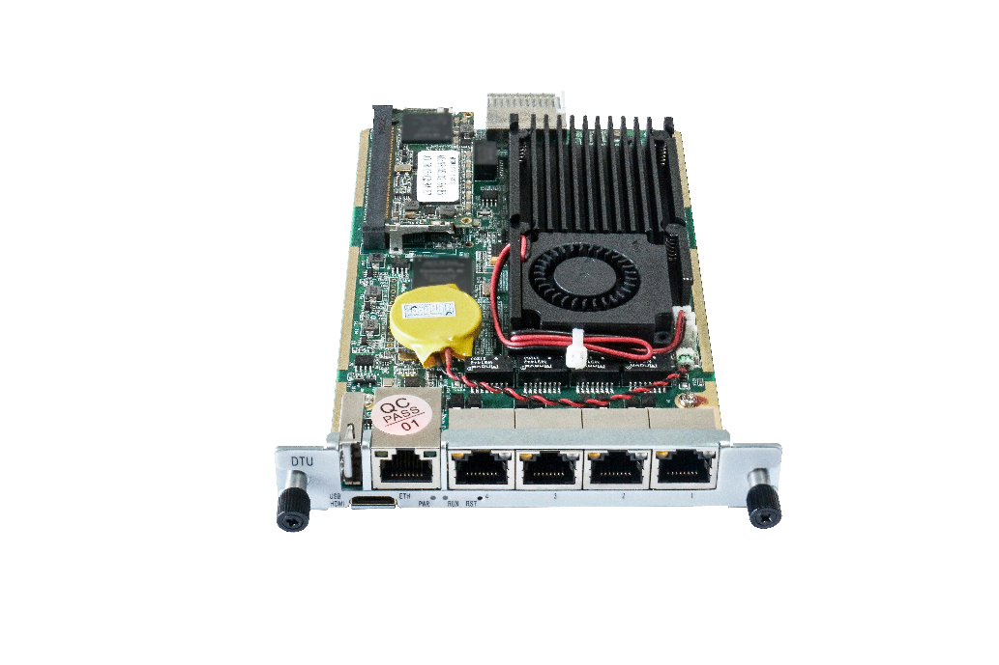
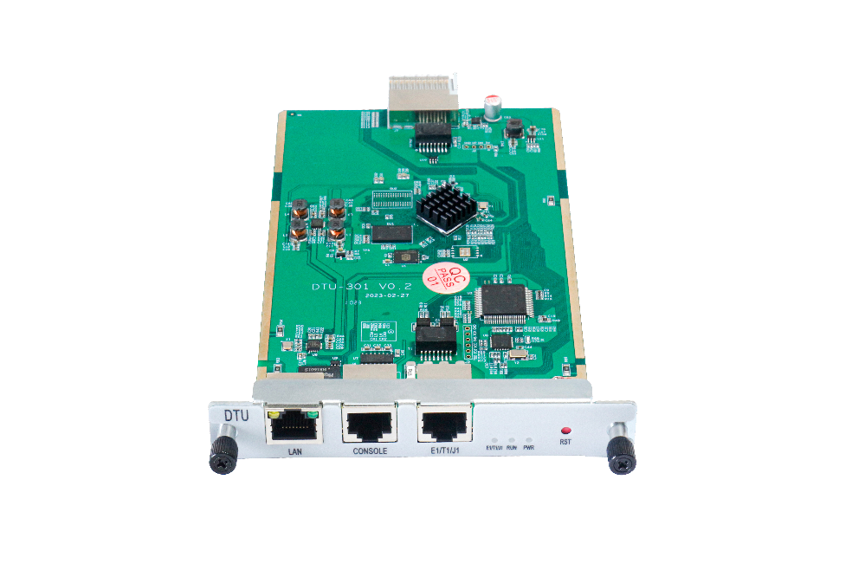
Unified Communication Platform —— Module Unit
Provides 2 audio ports
Bring users excellent HD voice service with multiple codecs, G.711a、G.711
Supports 2/4 software-selectable E1/T1/PRI interface
Supports up to 60/120 concurrent calls
Supports 1 software-selectable T1/E1/PRI interface
Supports up to 30 concurrent calls
ACU
DTU-4
DTU-301

Slide 33
Unified Communication Platform —— Module Unit
2.5-inch mechanical hard drive or 2.5-inch solid state drive
SEU
Support RAID 0 and RAID 1
For the purpose of performance enhancement or data redundancy
RSU

Slide 34
Products
01
Unified Gateway
X1911 、 X1960 、 X1981
02
Integrated Access Device
UScale Series
S196 、 S1224
Notes:
大类介绍版式1

Slide 35
UScale ——Unified Gateway
UScale X1911
Supports up to 300 users
Provides max 36 FXO ports, max 12 E1/T1 Interfaces
Signalling: SS7, R2, PRI, QSIG, SIP
UScale X1960
Supports up to 1000 users
Provides max 84 FXO ports, max 28E1/T1 Interfaces
Signalling: SS7, R2, PRI, QSIG, SIP

Slide 36
UScale ——Unified Gateway
UScale X1981 Unified Gateway (IPPBX)
Supports up to 20,000 users
Provides max 72 FXO ports, max 24 E1/T1 Interfaces
Maximum 2,000 participants, maximum 660 meeting rooms, maximum 360 participants in a single venue
Core Voice Switching Equipment
Modular Design, Easy Installation, Hot-Swappable Single Boards

Slide 37
UScale ——Integrated Access Device
Support 32-96 analog user channels
Utilizing IP network transmission resources to reduce routing and maintenance costs of analog lines
Uscale S196
Support 32-224 analog user channels
Utilizing IP network transmission resources to reduce routing and maintenance costs of analog lines
Uscale S1224

Slide 38
Products
Analog Cards
A400、A810、A1610、A2410、FXS/O-100/400
ISDN BRI Cards
B100、B200、B400、B800P
Digital Cards
D130、D230、D430、D830、D1630E
Hybrid Cards
Telephony Cards
X204、B200M、D100M、FXO200M、FXS200M
Transcoding Cards
V100
Notes:
大类介绍版式1

Slide 39
Telephone Cards
Delivers the superior voice quality on both FXO and FXS interfaces in up to 24 ports
Contains 2 to 6 module banks
Each bank supports one analog interface
From 1 port to 8 ports of S/T BRI interface
Up to 16 Simultaneous Voice Calls over 8 ISDN BRI Lines
Optional hardware echo cancellers (DSP)
1 to 16 T1/E1/J1 ports
Up to 512 channels in E1 mode or 384 channels in T1/J1 modes
Supports up to 480 concurrent calls
Analog Cards
ISDN BRI Cards
Digital Cards

Slide 40
Telephone Cards
Transcoding Cards
Comes with the industry’s first PCI & PCI-E form factors design in one Single board
Can handle up to 32/64/128/256/400 Codec transformations without additional licensing fees for transcoding
Hybrid Cards
Supports 3 types interface: FXO/FXS, BRI and T1/E1/ J1
Each interface access 2 analog line
Provide 4 simultaneous voice calls over 2 ISDN BRI lines

Slide 41
Customers

Slide 42
Customers
Business
Partners
Trusted by over 100 partners worldwide

Slide 43
OpenVox
Add: Room 624, 6/F, Tsinghua Information Port, Book Building, Qingxiang Road, Longhua Street, Longhua District, Shenzhen, Guangdong, China 518109
PHONE: +0755－66630978
EMAIL: sales@openvox.cn
www.openvoxtech.com
关键字

Slide 44
THANKS
VoIP Gateway/ Unified Communication Platform
Uscale Unified Gateway/ IPPBX/ Telephony Card

